Slide 1
2015-2016 ROTARY YEAR
RI DISTRICT 2420
ROTARY CLUB OF ŞİŞLİ
ROTARY REFUGEE REINTEGRATION CENTER PROJECT
Şişli
Hizmetleriniz dünyaya armağan olsun
Kulübü

Slide 2
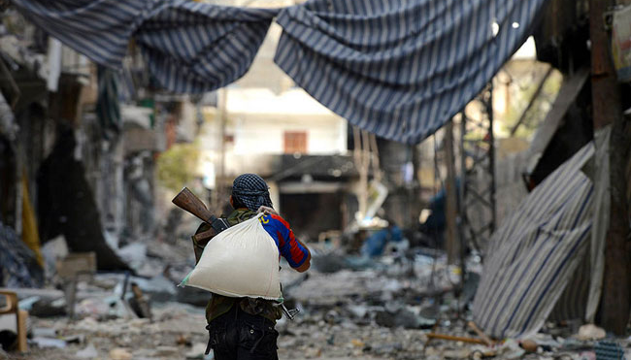
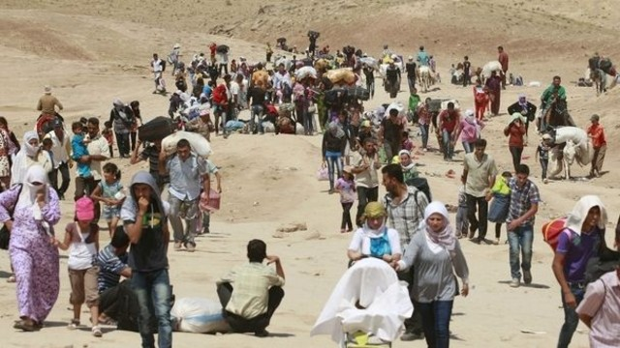
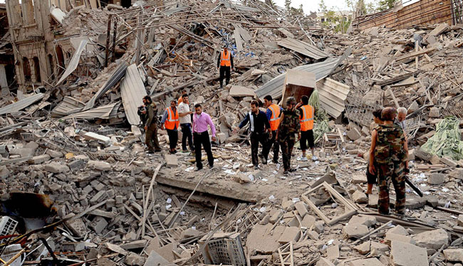
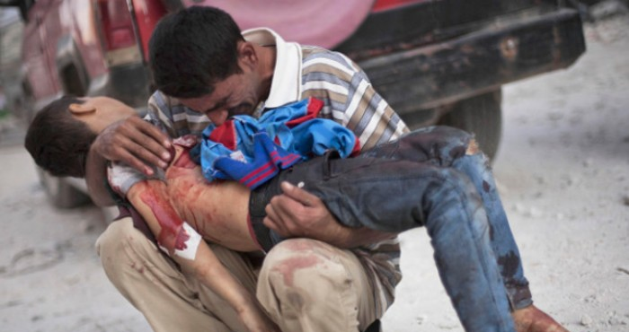
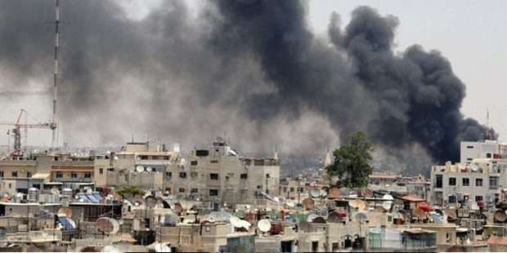
2015-2016 ROTARY YEAR
THE NIGHT BEFORE THEY HAD EVERYTHING..
IN THE MORNING THEY WOKE UP TO STRUGGLE FOR LIFE...
Şişli
Hizmetleriniz dünyaya armağan olsun
Kulübü

Slide 3
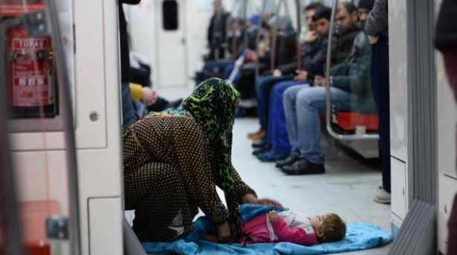
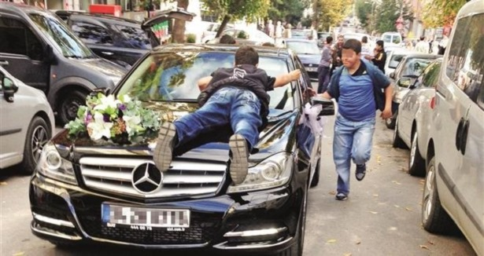
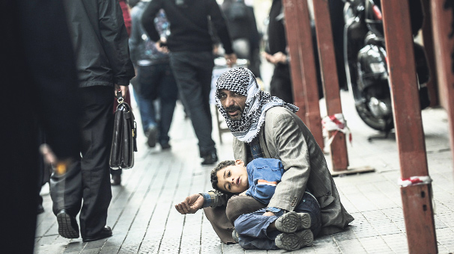
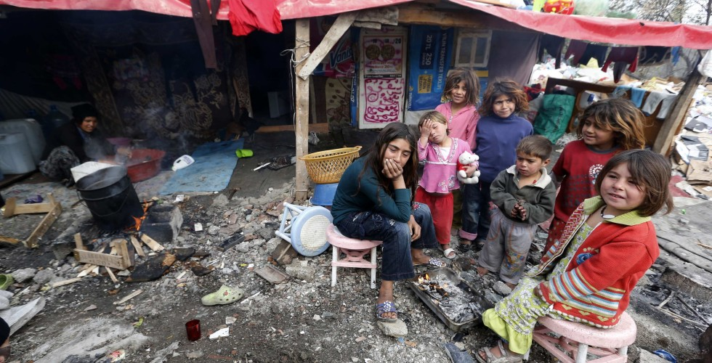
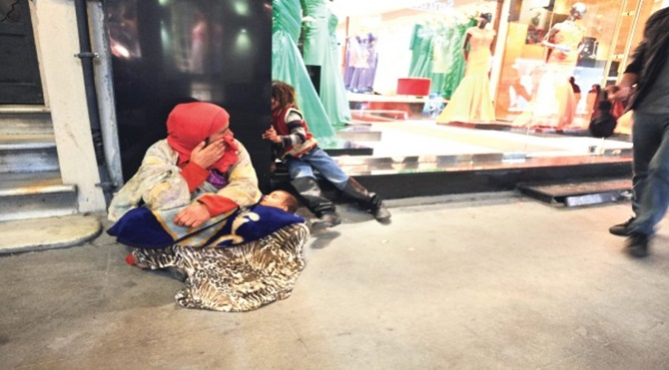
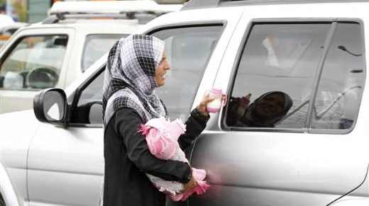
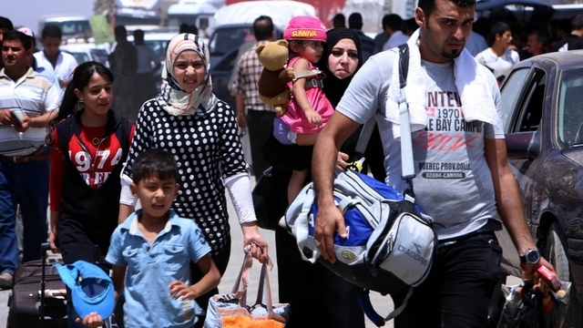
2015-2016 ROTARY YEAR
WE ACCEPTED THEM EVEN THOUGH RELUCTANTLY, BUT..
THEY BROUGHT TROUBLE AND THREAT TO OUR GEOGRAPHY
Şişli
Hizmetleriniz dünyaya armağan olsun
Kulübü

Slide 4
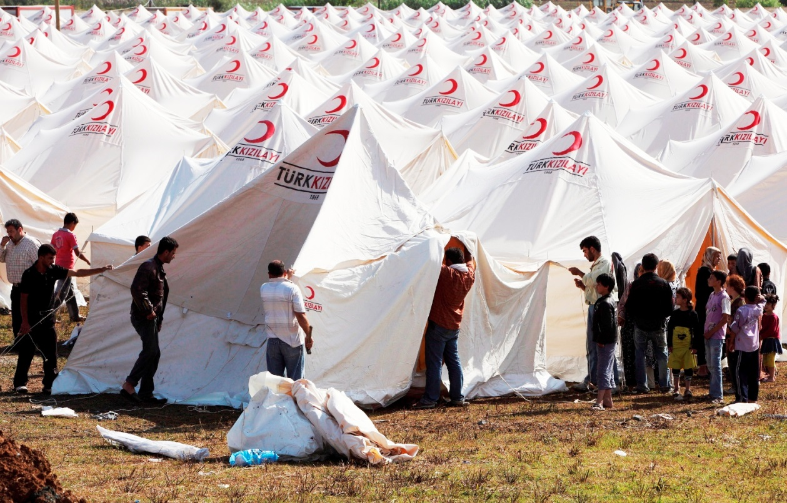
2015-2016 ROTARY YEAR
SOME MIGHT BE OPTIMISTIC ENOUGH TO THINK THAT THEY WILL RETURN
BUT THE REALITY IS APPARENT
THEY ARE MORE THAN 3.000.0000 PEOPLE NOW
Şişli
Hizmetleriniz dünyaya armağan olsun
Kulübü

Slide 5
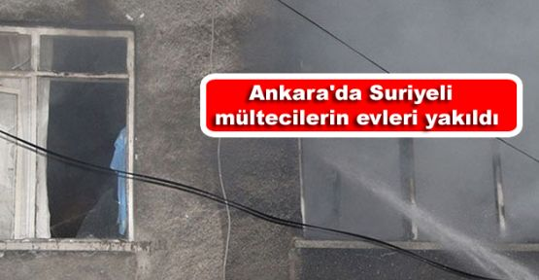
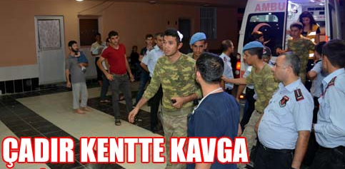
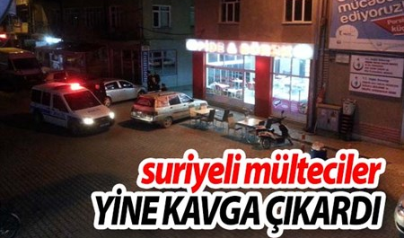
2015-2016 ROTARY YEAR
NOW IT’S TIME TO TAKE ACTION NOT ONLY FOR REFUGEES
BUT ALSO FOR ENTIRE HUMANITY...
BECAUSE BOTH REFUGEES AND HOSTS ARE
LOSING TEMPER ...
Syrian Refugees’ house put on FIRE
Fight in Tent Shelter Houses between Syrian Refugees
Syrian Refugees fight with Turkish group
Another fight caused by Syrian Refugees in Etimesgut
Şişli
Hizmetleriniz dünyaya armağan olsun
Kulübü

Slide 6
2015-2016 ROTARY YEAR
SOLUTION..
ROTARY REFUGEE
REINTEGRATION
CENTER
RRRC
T.K.Merkezi
Şişli
Hizmetleriniz dünyaya armağan olsun
Kulübü

Slide 7
2015-2016 ROTARY YEAR
WITH ROTARY REFUGEE REINTEGRATION CENTER
A consultancy center will be constructed / renovated within Istanbul City borders for mainly
Syrian Refugees whose population has reached %5 of entire Turkih population nowadays
In order to facilitate well communication with Syrian Refugees Arabic speaker employees will
be positioned in the center
With help of Sponsors and Government and upon request of applicants a basic health
inspection will be carried and simple emergency clinical interventions will be done
The center will not provide Food and Shelter but will guide applicants how to benefit from
already provided services of municipal or federal government
Şişli
Hizmetleriniz dünyaya armağan olsun
Kulübü

Slide 8
2015-2016 ROTARY YEAR
WITH ROTARY REFUGEE REINTEGRATION CENTER
The center will mainly provide information about life in Turkey, and give tips on how
Refugees shall adapt themselves to be able to live safely in Turkey.
The personal qualities and qualifications of refugees will be recorded and in case of
a demand from employers for such qualified labor, a matching will be done.
In case of having no specific qualifications for getting a job, applicants will be guided to
attend language and vocational courses. Such courses will also be given in RRRC too.
RRRC will try to reach refugees’ ralatives from whom refugees could not receive any news
In case of availability of secure places for return to their home countries RRRC will guide
applicants to understand means of returning.
Şişli
Hizmetleriniz dünyaya armağan olsun
Kulübü

Slide 9
2015-2016 ROTARY YEAR
ROTARY REFUGEE REINTEGRATION CENTER
The project has been planned to be completed together with 2 or 3 more Rotary Clubs
from the other Rotary World Districts
Benefiting from municipal and federal government sources a field and a proper building
will be provided for internal and external renovation
Rotary will fund the centers sources via government, volunteers and sponsor efforts during
Rotary year 2016-2017 and will optimise actual facilities of the center
Starting from July 2017 the center will transferred to authority of government in order to
provide long term services, nevertheless it will continuously be supported by Rotary
The center will not only service Syrian Refugees but will service all Refugees of all nations.
Şişli
Hizmetleriniz dünyaya armağan olsun
Kulübü

Slide 10
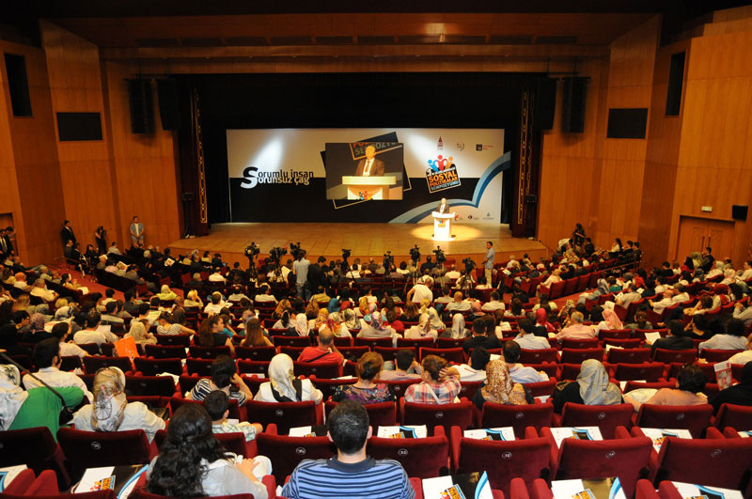
2015-2016 ROTARY YEAR
ROTARY REFUGEE REINTEGRATION CENTER PROJECT FUND SOURCES
Rotary Club of Şişli and the supporter ARI Organizasyon company will organize a huge concert in April 2016 with supports of 10 high level well known Turkish and International singers. In order to fit all singers concert will be
play-back type. Singers may sing up to 2 songs
Current relationships with singers such as Orhan Gencebay, Kenan Doğulu, Sertab Erener, Ferhat Göçer, and Coşkun Sabah are ready and proposals will be made within July 2015. CRR or Lütfi Kırdar concert centers are foreseen locations of the concert
Şişli
Hizmetleriniz dünyaya armağan olsun
Kulübü

Slide 11
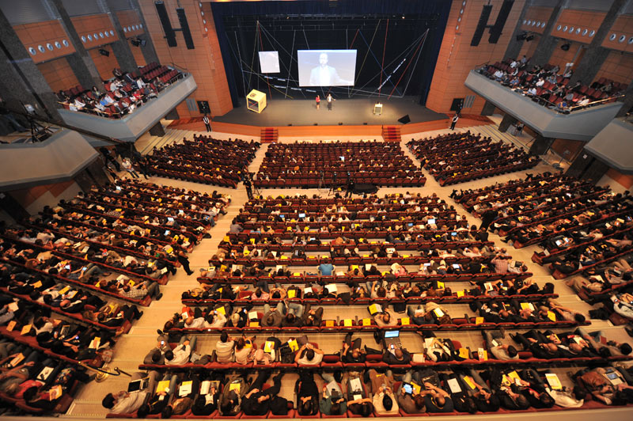
2015-2016 ROTARY YEAR
ROTARY REFUGEE REINTEGRATION CENTER PROJECT FUND SOURCES
In case if a partner Rotary club from the
world would like to attend the project, we
expect them to organise a well knows singer’s
attendance to the concert. The center than
Will carry also those Rotary Club’s names
A big media channel will sponsor the project against live broadcast of the convert.
A planned income of apprx 200.000 Euros will be received via ticket sales, live broadcast and entire sponsorships
Şişli
Hizmetleriniz dünyaya armağan olsun
Kulübü

