Slide 1
International
Seminar
Health
Youth
Education
Friendship
Neglected problems of Malaria and other related mosquito-borne diseases
Version 16-02-2019
Pristina (Kosovo) 11-14 April 2019

Slide 2
International
Seminar
Pristina (Kosovo)
11-14 April 2019
Neglected problems of Malaria and other related mosquito-borne diseases
A project by
Rotary Club Radolfzell-Hegau (D)
Rotary Club Sisli-Istanbul (TR)
Rotary Club Prishtina International (Kosovo)
Promoted by
Rotary District 2420 (TR)
Organized by
ICC Deutschland – Türkei

Slide 3
Mission Rotary Malaria Seminar 2019
with focus on Health – Youth – Education - Friendship
Recognize risks of Malaria and other related mosquito-borne diseases, recognize regional and cultural differences, improve own knowledge and make friends

Slide 4
Why Malaria now?
Some facts about Malaria only
Every minute, a new person becomes infected and
Every 2 minutes, a child under 5 dies of malaria
Malaria incidence is 219/1000 in Africa
Other mosquito-borne illnesses, which gain a rising attention also in Europe, are diseases caused by bacteria, viruses or parasites transmitted by mosquitoes (like Dengue fever and West Nile virus)
Based on existing WHO knowledge we will learn more facts about transmission, prevention and existing limitations
We will develop ideas to raise the awareness of the global impact of these diseases and further explore ways to improve prevention and to reduce the risk of infection

Slide 5
The Seminar
International Rotary Seminar 11-14 April 2019 at University Pristina, Kosovo
Target 40 young people from different European countries with different mind and skill set
Learn about Malaria and other related mosquito-borne diseases and elaborate new ideas to fight against them globally
Apply innovation methodologies established to create innovative ideas in short time
Cultural exchange with international students, interests, curious and open-minded people
Present ideas and results back to WHO, University and Rotary International

Slide 6
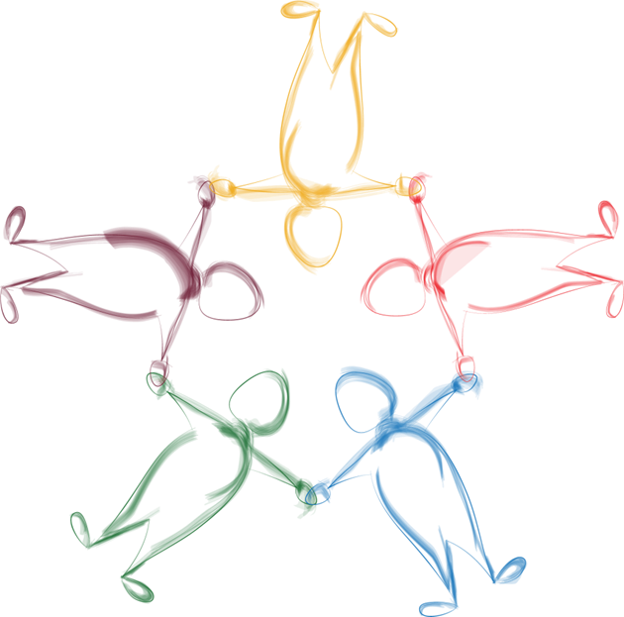
We will create ideas in short time with applied innovation methodology
.
Design Thinking will help to unleash the power of human’s creativity, to understand people’s needs and to design the right solution for them.
This methodology is bringing together a good approach, with the right people, in the right environment – with fun and cultural exchange!
The core components are:
3-4 Multi-disciplinary teams each consisting of 4-6 people
with a culture of empathy
An environment with a culture of trust and the space/material for creative teamwork
Approach that is a highly iterative process consisting of activities

Slide 7
Our Workshop Agenda for 2,5 days (1/2)
.
Part I: Understand Problem
Kick-Off
Introduction, Team Forming
Overview and Introduction to Design Thinking
Scoping
Intro to the Design Challenge
Completion of the Scoping
360° Research
Introduction to 360° Research
Speakers and experts from WHO
Research
Synthesis
Introduction to Synthesis
Storytelling & wall of data creation

Slide 8
Our Workshop Agenda for 2,5 days (2/2)
.
Part II: Create Solutions
Ideation
Generate ideas, build up and blend ideas
Cluster and prioritize ideas
Prototyping
Introduction to Prototyping
Prototyping of solutions
Validation
Iterate prototype
Presentation & feedback to WHO experts
Final Iteration and summary
Finalization of best ideas
Consolidate results for further use
Wrap Up
Review / Feedback

Slide 9
Organisational Setup
Team: 40 Young People from 4-5 different countries
Age 18-30 years
Preferably, but not restricted to Rotaract members
10 each from Germany, Greece, Kosovo, Serbia, Turkey
Ideally with knowledge about medicine, biology, chemistry, pharmaceuticals, marketing, digital industries (IT), and/or agriculture
Speakers:
Specialist of World Health Organisation (WHO)
Specialist of World Mosquito Control Association (WMCA)
Preparation and Moderation
Specialists from SAP
Infrastructure and local Organization
RC Pristina for the Organisation (University of Pristina)

Slide 10
Steering Committee and Organisation
Steering Committee: Wolfgang Uebel (DE), Manfred Raupp (DE), Nevin Can (TR), Marjan Dema (Kosovo), Ilir Krasniqi (Kosovo).
Organisation: Cornelia Bambini-Adam, Dashamir Berxulli, Ethem Ceku, Murat Celik, Matthias Feil, Heiner Grönewald, Sabri Kurdoglu, Erik Mackinlay, Manfred Raupp, Wolfgang Uebel, Rotary Members Pristina International
Local coordination: Dashamir Berxulli (University), Erik Mackinlay (Rotary)
Place of seminar at classrooms of Pristina University
Lodging, Food, Festival, Transportation by RC Members Pristina International
Future ICC Deutschland Kosovo Wolfgang Uebel – Dardan Velija

Slide 11
Publication of Results (DRAFT)
Press conference/article after the seminar at University Pristina
Conference paper published by the University Pristina
Forwarding key results to WHO
Result presentation at the RI World Convention in Hamburg June 2019
National RC press releases
World Malaria Day April 25

Slide 12
Thank you for supporting the International Rotary Seminar in Pristina

